Slide 1


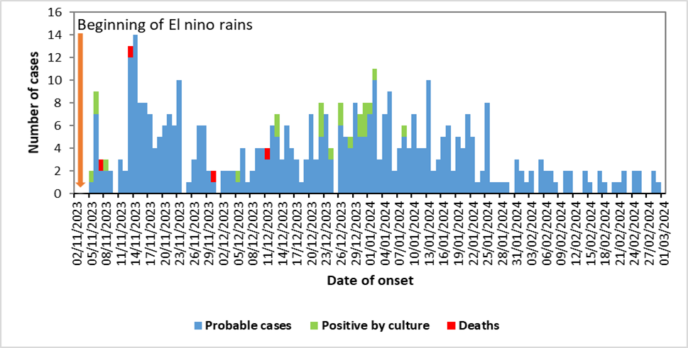
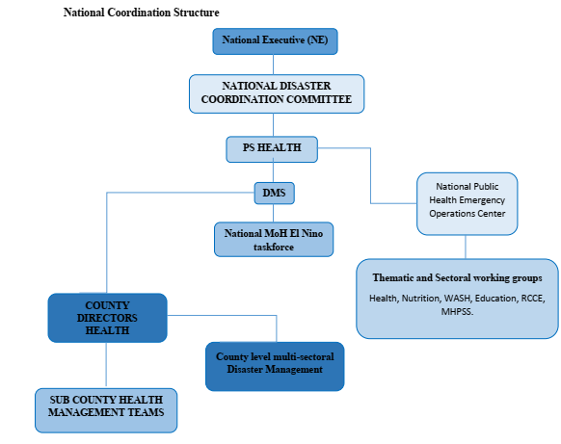
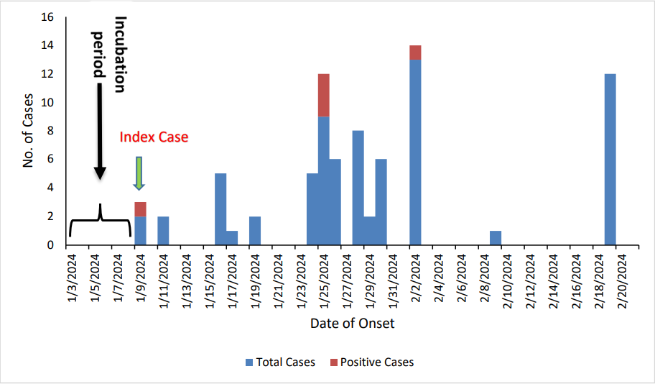
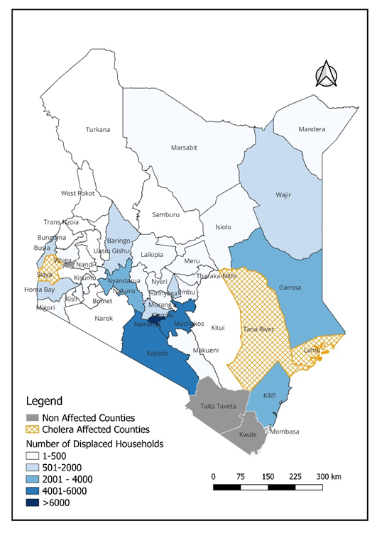
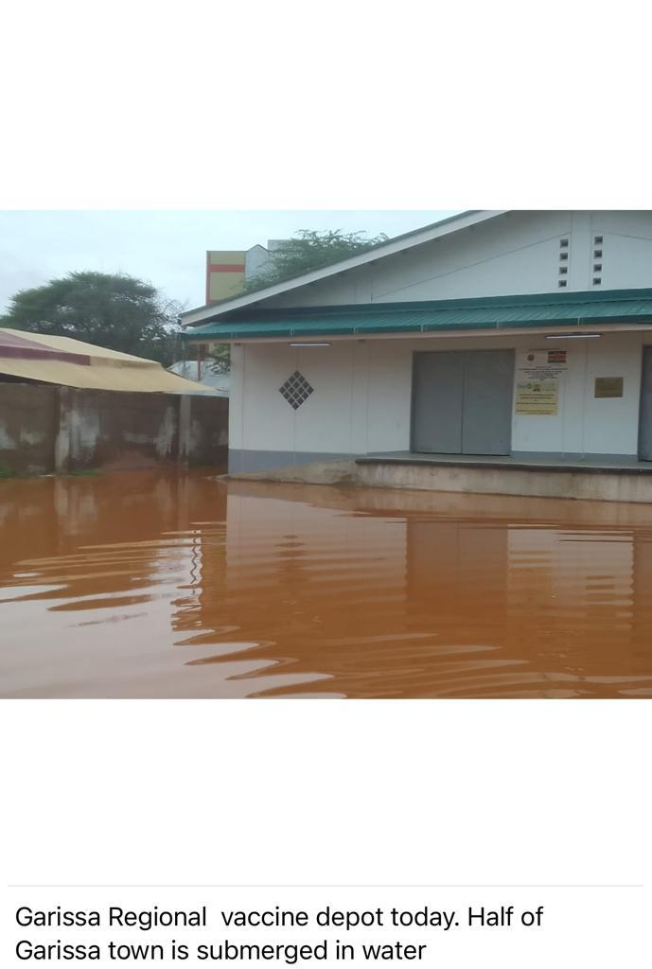



Exploring El Niño's Public Health Impacts in Kenya, 2023–2024: A One Health Perspective
Valentine Kabita¹*, Aaron Kimeu³, Michelle Wangui¹, Samuel Nyansiri⁵, Francis Muoka¹, Hilary Limo¹, Kanana Kimonye⁴, Daniel Langat²
1:National Public Health Emergency Operations Center-KNPHI, Ministry of Health, Nairobi, Kenya 2:Division of Disease Surveillance and Response-KNPHI, Ministry of Health, Nairobi, Kenya 3:Emergency and Disaster Risk Management-KNPHI, Ministry of Health, Nairobi, Kenya 4:Kenya National Public Health Institute, Ministry of Health, Nairobi, Kenya 5:National Disaster Operations Centre, Ministry of Interior, Nairobi, Kenya
BACKGROUND
Kenya experienced enhanced rainfall from September 2023–February 2024 due to El Niño
Rainfall was initially forecast to peak in Nov–Dec 2023 but extended into early 2024
The prolonged heavy rains resulted in flooding, displacement, infrastructure damage, and heightened risk of climate-sensitive health threats
RESULTS
Forty-five (45) Counties affected.
Deaths :178, 40 missing persons, and 242 injuries. (NDOC)
Households affected: 60,367 (384,216 individuals) displaced into 170 IDP camps. (NDOC)
A 5% (64/1434) of health facilities across 11 counties became inaccessible.
Climate-sensitive disease threats emerged, including
  Cholera (409 cases, 4 deaths; CFR 0.97%) affecting 5/47 counties: Lamu accounted for 80% (326) of the cases.
Seven (7) human Rift Valley Fever cases were reported in Marsabit 71% (5) and Wajir 29% (2), alongside 4 confirmed livestock cases.
Malaria upsurges were documented in Wajir (373), Marsabit (975), and Kitui (535).
Social vulnerabilities were exacerbated, with 50 GBV cases reported across 9/47 counties.
OBJECTIVE:
To describe public health impacts of the 2023–2024 El Niño event in Kenya
To document the coordinated, multi-sectoral response, framed within a One Health approach.
METHODOLOGY:. Descriptive cross-sectional analysis
Data were collected from the National Disaster Operations Centre (NDOC), Kenya Meteorological Department (KMD), and all 47 counties
          A standardized reporting tool shared with County Disease Surveillance Coordinators.
Daily reports captured: weather alerts, affected populations (injuries, deaths, displacement), GBV cases, disease outbreaks, and health infrastructure damage.
Real-time data analysis conducted at national level
Findings disseminated through daily Situation Reports (SitReps)
SitReps used to guide timely decision-making and coordinated response by MOH, other line ministries and partners
Figure 3: Distribution of Cholera cases in Kenya, Nov 2023 – Feb 2024
Figure 1: National Coordination Structure. (Adapted: Kenya Health Sector El Nino Contingency Plan
STUDY AREA: All 47 counties, Kenya
Figure 4: Human Rift Valley Fever Epi Curve Marsabit & Wajir Counties, January - February 2024.
Figure 5: Garissa Regional Vaccine depot marooned by floods during El Nino rains, 2023-2024
DISCUSSION & CONCLUSIONS
El Niño highlights the growing intersection between climate variability and health security in Kenya
Need to strengthen: Integrated (One Health) surveillance, Early warning and response systems, Resilient health infrastructure, RCCE
A One Health, whole-of-government approach is key to improving preparedness and resilience
Figure 2: Map of Kenya showing affected counties
Contact: valentinekabita@gmail.com

